Slide 1

6th Grade Accelerated Math
Unit 6, Lesson 7 Subtracting Integers Using Number Lines
Volume 1, pg. 264

Slide 2


Benchmark
MA.6.NSO.4.1
Apply and extend previous understandings of operations with whole numbers to add and subtract integers with procedural fluency.
volume 1, pg. 264

Slide 3
Integrated Mathematical Thinking and Reasoning Standards
MA.K12.MTR.5.1 Use patterns and structure to help understand and connect mathematical concepts.
MA.K12.MTR.6.1 Assess the reasonableness of solutions.
volume 1, pg. 264

Slide 4

Learning Targets
I can subtract integers using a number line.
I can use number lines to understand how the rules for adding integers are related to the rules for subtracting integers.
volume 1, pg. 264

Slide 5

Warm-Up
volume 1, pg. 265

Slide 6
6.7.1 Warm-Up: Bell Work
Draw integer chips that represent the expression below and evaluate.
7 − (−3)
volume 1, pg. 265

Slide 7

Guided Instruction
volume 1, pg. 265

Slide 8
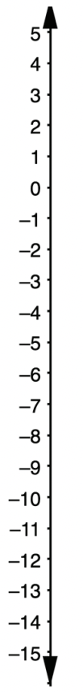
6.7.2 Guided Instruction: Subtracting Integers Using a Number Line
The temperature in degrees Fahrenheit (℉) of a city in Alaska was 4− ℉. After sunset, the temperature dropped 6℉.
Represent the change in temperature on the number line.
Write the subtraction number sentence that is represented from the context and on the number line.
After the decrease in temperature, what was the temperature?
Represent the temperature change using integer chips to verify the solution.
volume 1, pg. 265

Slide 9
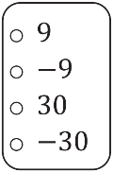
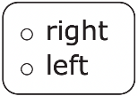
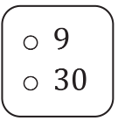
Complete the statements to explain how to represent subtraction on a horizontal number line.
a. To find the difference of −9 − (−30), start by plotting
on the number line first.
b. The subtraction sign indicates moving to the
on the number line, but it is followed by
a negative sign with 30, which requires moving in
the opposite direction.
c. Therefore, the answer will be found by moving
units to the
of −9 on the number line.
volume 1, pg. 266

Slide 10
3. Show the subtraction on the number line below.
The difference of −9 − (−30) is ______
volume 1, pg. 266

Slide 11

Collaboration
volume 1, pg. 266

Slide 12

6.7.3 Collaboration: Relating Integer Addition and Subtraction
Three contexts are given below. Choose one context to work on with your partner. Circle your choice.
Context A | Tamara didn’t realize she had a balance of $19 in her bank account when she used her bank card to purchase a $50 purse. When the purchase is processed by the bank, what will be her new account balance?
Context B | The elevation of the top floor of a parking garage in Death Valley, California, is 282 feet (ft) below sea level. A car that leaves the parking garage from the top floor loses 72 ft in elevation before reaching the street. What is the elevation of the street?
Context C | Ginny mows lawns for her summer job. Before she started mowing, she spent $32 on gas for the lawn mower. Then, she spent another $17 on other supplies she bought at the hardware store. What were Ginny’s total expenses?
For the context selected, represent the mathematics in the context in each of the following ways.
1. Draw a number line to represent the given context.
volume 1, pg. 266

Slide 13
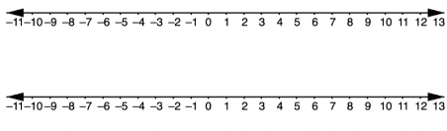
Write two equations that can be used to find the solution to the question in the context. One equation should use subtraction and the other should use addition.
Create a group of four by joining with another pair of students. Verify your work by exchanging with the other pair of students
Continue working with the group of four to complete the table.
Example Subtraction Problem | Example Rewritten as an Addition Problem | Number Lines: Show the subtraction on the top number line and the addition on the bottom number line.
10 − 7 = 3 | 10 + (-7) = 3
7 − 10 = -3
volume 1, pg. 267

Slide 14
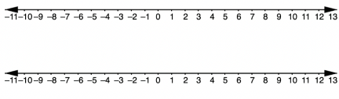
Example Subtraction Problem | Example Rewritten as an Addition Problem | Number Lines: Show the subtraction on the top number line and the addition on the bottom number line.
8 − ⁻3− = 11
⁻5 − 3 = ⁻8
⁻7 − ⁻15 = 8
⁻9 − ⁻7 = ⁻2
volume 1, pg. 267

Slide 15







When subtracting integers, problems can be rewritten as an addition problem using the additive inverse of the second integer.
Describe one advantage of changing a subtraction problem to an addition problem.
Complete the table by rewriting the second integer in the subtraction model as its additive inverse and indicating the sign of the value of either expression. The first row has been completed. Once your group is done, split back into pairs and check your table with a different pair of students.
Visual Model of Subtraction | Visual Model of Addition | Sign of the Answer
 |  | +
volume 1, pg. 268

Slide 16

Your Turn
volume 1, pg. 268

Slide 17
6.7.4 Your Turn!
1. Represent each subtraction statement on a number line and find the value of the expression.
a. −19 − 11 = _____
b. 12 − (−28) = ____
c. (−14) − (−15) = _____
volume 1, pg. 268

Slide 18

Wrap-Up
volume 1, pg. 269

Slide 19
6.7.5 Wrap-Up: Reflection
Draw an X on each line to indicate where your current learning is related to each target.
I can subtract integers using a number line.
I need help.
I can’t get started.
I’m getting there, but I need more practice.
I understand this,
and I feel confident.
I can use number lines to understand how the rules for adding integers are related to the rules for subtracting integers.
I need help.
I can’t get started.
I’m getting there, but I need more practice.
I understand this,
and I feel confident.
volume 1, pg. 269

